Slide 1
future plans

Slide 2
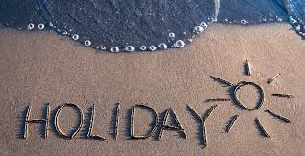
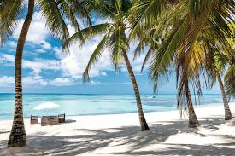


Slide 3
When we know about the future, we normally use the present tense.
We use the present simple for something scheduled:
We have a lesson next Monday.
The train arrives at 6.30 in the morning.
The holidays start next week.
It's my birthday tomorrow.
2. We can use the present continuous for plans or arrangements:
I'm playing football tomorrow.
They are coming to see us tomorrow.
We're having a party at Christmas.
3. We use will: when we express beliefs about the future:
It will be a nice day tomorrow.
I think Brazil will win the World Cup.
I'm sure you will enjoy the film.

Slide 4
4. We use be going to to talk about plans or intentions:
I'm going to drive to work today.
They are going to move to Manchester.
to make predictions based on evidence we can see:
Be
careful! You are going to fall. (= I can see that you might fall.)
Look at those black clouds. I think it's going to rain. (= I can see that it will rain.)
5. We use will be with an -ing form for something happening before and after a specific time in the future:
I'll be working at eight o'clock. Can you come later?
They'll be waiting for you when you arrive.

Slide 5
1. Los Angeles is a great city. I'm sure you
(have) a good time there.
2. I'm not sure but we (see) Catrina at the funeral tomorrow.
3. I've already decided. I (phone) my bank manager tomorrow.
4. The next course (start) on 1 July. That's what the website says.
5. The meeting (be) over by six. They don't usually take more than an hour.
6. I (help) you do the washing up if you like.
7. Bella and I (get) married in the summer. We've already agreed on the date.
8. This time tomorrow we (fly) to New Zealand. We'll be about halfway through the flight.
9. We (run out) of coffee soon. The tin's almost empty.

Slide 6
Jim Gaffigan & His Non-Existent Plans For The Summer
Listen two or three time please
https://app.fluentize.com/lesson/gaffigan-summer

Slide 7

Is the summer for JIM a time for relaxing or to plan something?
What does all the summer destination pursuit?
How does he call the beach?

Slide 8

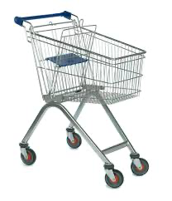
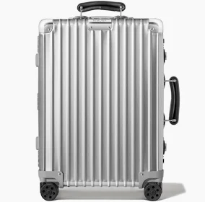
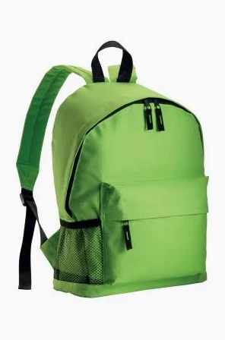
Before …when get to the airport
Our trolley is in ENGLISH
shopping cart
Hand luggage
BACKPACK
SUITCASE

Slide 9
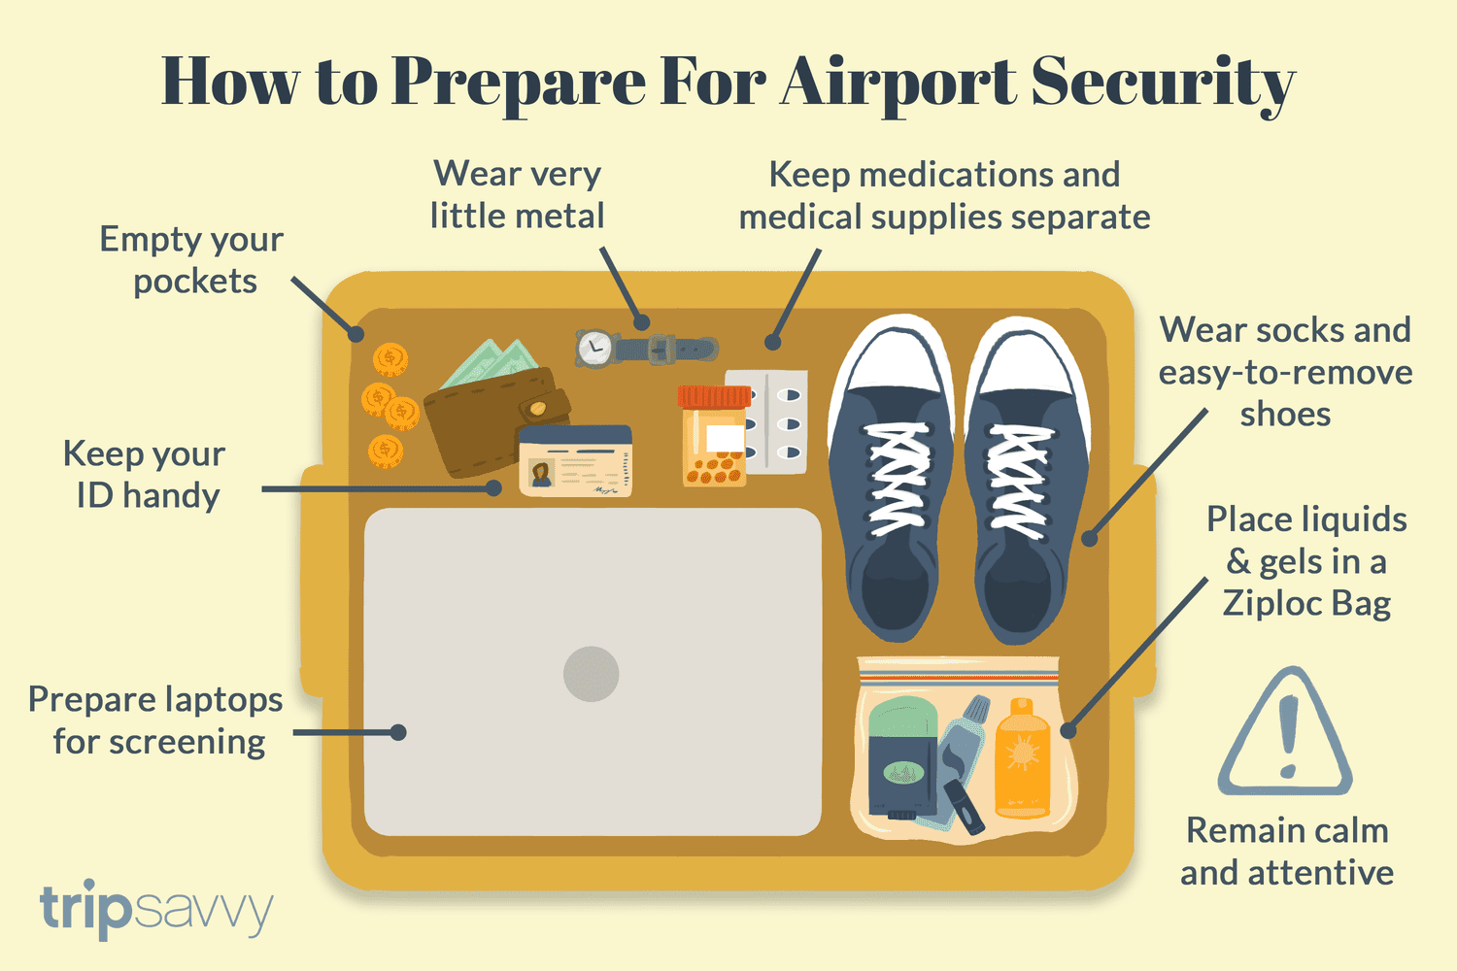
to put laptops –phone- watches belts –sunglasses- metallic jewellery –hats any liquid in the tray please

Slide 10
Summertime State Of Mind-
What’s your idea about …
Tell me about your future vacation plan using the future tence:
Where will you go on your next holiday?
What activities are you going to do?
Why did you choose this destination?

Slide 11
I am going to...
i will... sunbath
swim
relax
read a book
meet friends
meet family relatives
dance until the morning
sleep during the day
having a long siesta
enjoying my time

Slide 12


