Slide 1
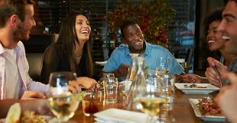
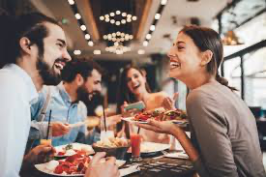


Slide 2
1. How often do you go out to eat?
2. What are your favorite restaurants in the area where you live?
3. What kind of restaurants do you prefer cosy and informal or a starred restaurant ?

Slide 3
How can we book a table at the restaurant ?
Watch this video … and give it a try
https://youtu.be/jQKQzskWG5M
provaci

Slide 4
Making a Reservation (A2)
Choose the correct answer according to the information in the video.
1 Anna wants her reservation to be on / at Tuesday on / at 7 PM.
2 The Google Assistant needs 15 minutes / 50 minutes to make the reservation.
3 The Google Assistant canceled / confirmed Anna’s reservation after she made it.
Let’ s see the right responses
GREAT JOB!
YOU NAIL IT!
Anna’s reservation is on Tuesday at 7:00 PM.
(2) The Google Assistant needs 15 minutes to make the reservation.
(3) The Google Assistant confirmed the reservation with Anna after making it.

Slide 5
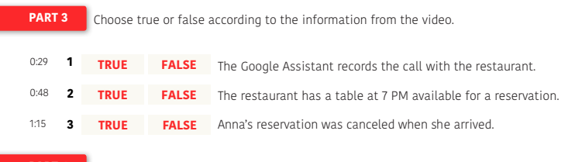
GREAT !
(1) True (2) False (3) False

Slide 6
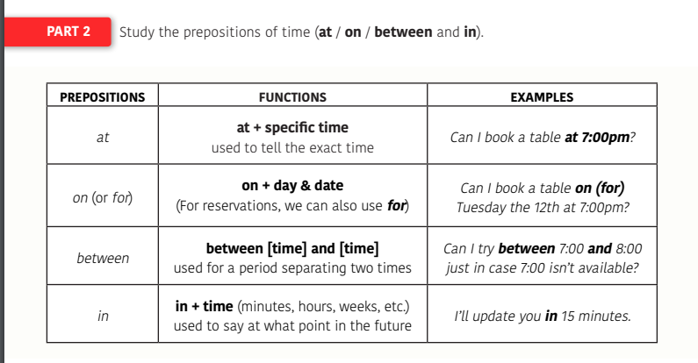

Slide 7
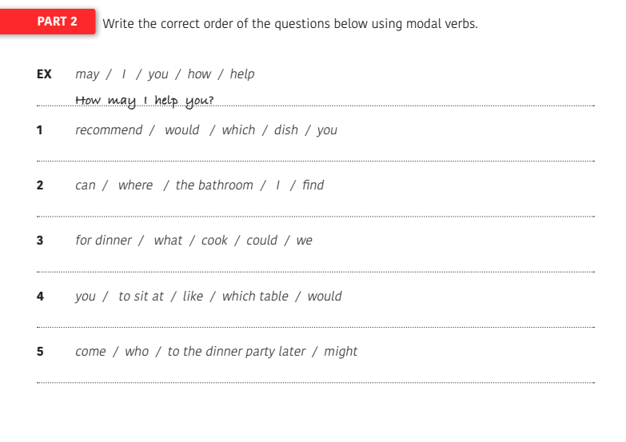

Slide 8
Part 2.
Questions using modal verbs (word order).
(1) Which dish would you recommend?
(2) Where can I find the toilet?
(3) What could we cook for dinner?
(4) Which table would you like to sit at?
(5) Who might come to the dinner party later?

Slide 9
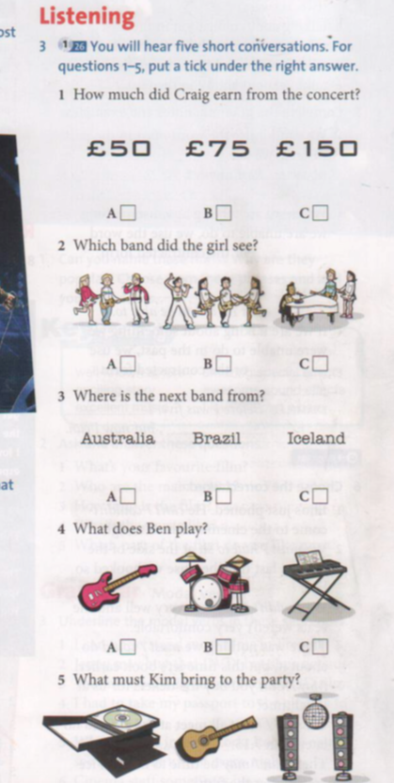

CAN YOU WRITE ON YOUR COPY THE RIGHT ANSWER
1:A
2:B
3:C
4:B
5:A

Slide 10
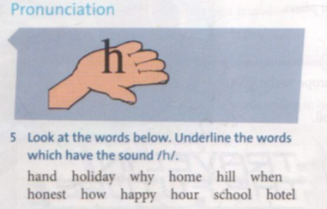

Slide 11
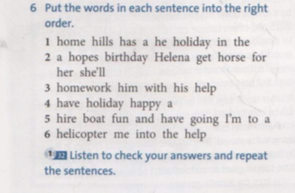

Slide 12
Lets’ watch a video

Slide 13
https://youtu.be/HSlbU_ZW6fk
Lets’ find out the main questions

Slide 14
What is the woman looking for ?
A small black sweater or a medium black sweater ?
What’s the price of the swaeter 43,38 or 39,99
What is the woman looking for ?
What’s the size of the shirt ?

Slide 15
How do you ask POSSO PROVARE ?
Can i try i on ?
Can i prove it ?
How do ask POSSO AVERE UNA TAGLIA PIU GRANDE?
Can I have a huge or little size
Can I have a smaller or a bigger size ?

Slide 16

Do you like watching films?
Do you thing it’s relaxing?;
Does it free your mind?
Do they elp to understand stories/ history?

Slide 17
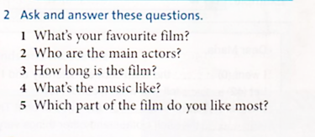
Do you know these films?
Do you know these actors?

Slide 18
Let’s talk about film now Film UK or movies USA ?
Type of Film | Characteristics
Horror Films | Movies with monsters
Action Films | Movies with battle, fights and stunts
Family Movies | Films for children and adults
Martial Arts Films | Movies about MMA fighters
Adventure Films | Movies that take place in exotic places
Comedies | Movies intended to make laugh
Romantic Films | Movies about love stories
Documentaries | Films about real life stories
Animated Films | These are usually cartoons
Super Hero Movies | Films about heroes from comic books
Drama | Movies about sad and difficult situations

Slide 19
Have you got a favourite actor/ actress ?
What’s your favourite film director?
Where Is The Film Set?
TAKE TWO MINUSTES TO TALK ABOUT THIS WITH YOUR PARTNER…

Slide 20
Now try to respond
What kind of movies do you like?
What’s your favorite movie?
What’s your favorite horror movie?
What’s your favorite drama film?
What do you think about super hero movies?
What’s your favorite actor or actress?
Which horror movie is the scariest? Why?
Do you like independent films?
What movies are you looking forward to watching?

